Slide 1
NITIN KUMAR PATEL Smart agriculture system based on IoT Internship ID - SB43119

Slide 2
Project analysis slide 2
Basic Chart
IBM CLOUD
IBM SIMULATOR SENSOR
UI
NODE-RED
IBM WATSON IoT PLATFORM
PYTHON IDLE
OPEN WEATHER API

Slide 3
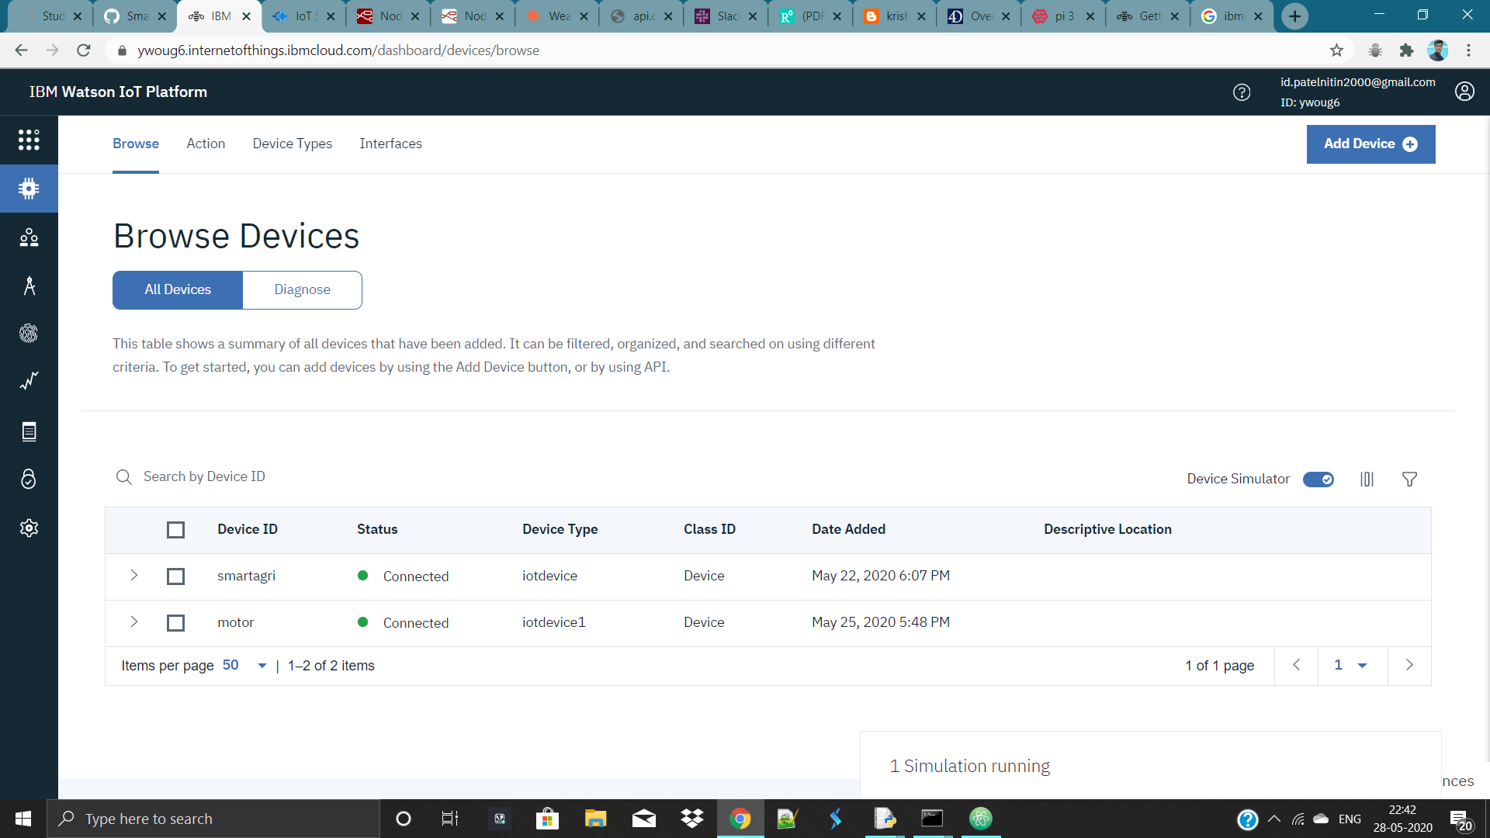
IBM WATSON IOT PLATFORM

Slide 4
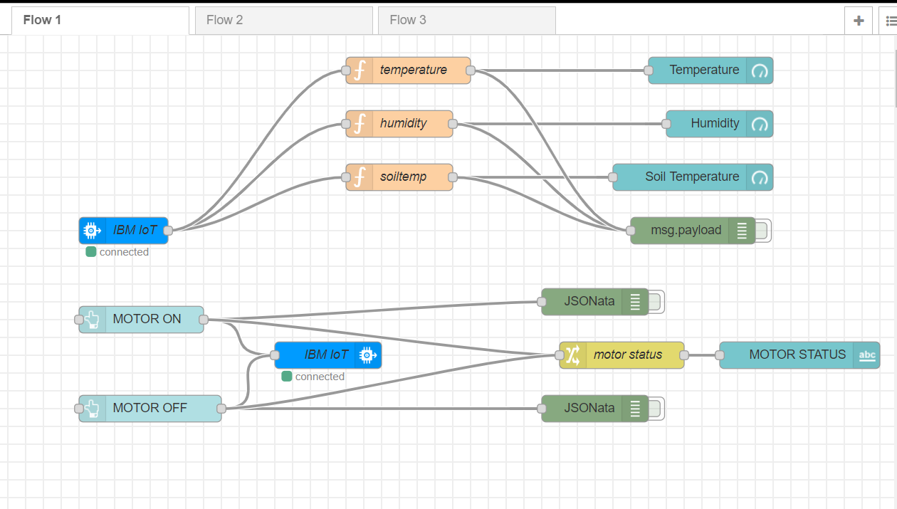
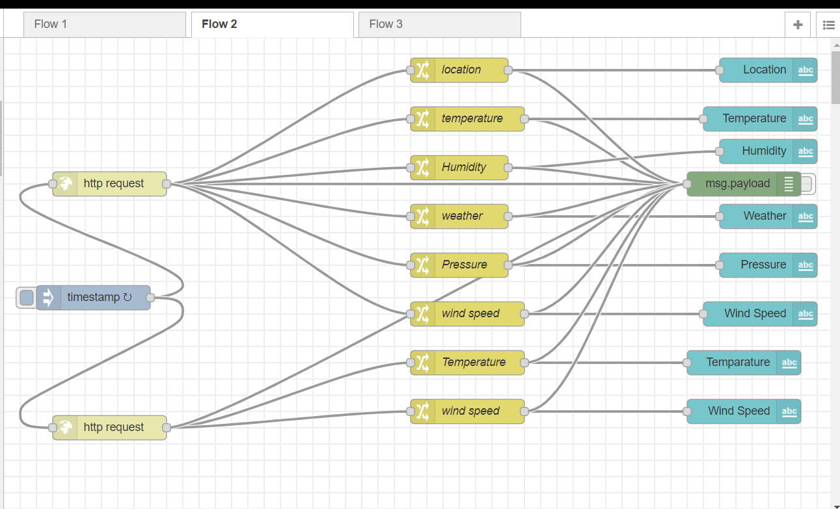
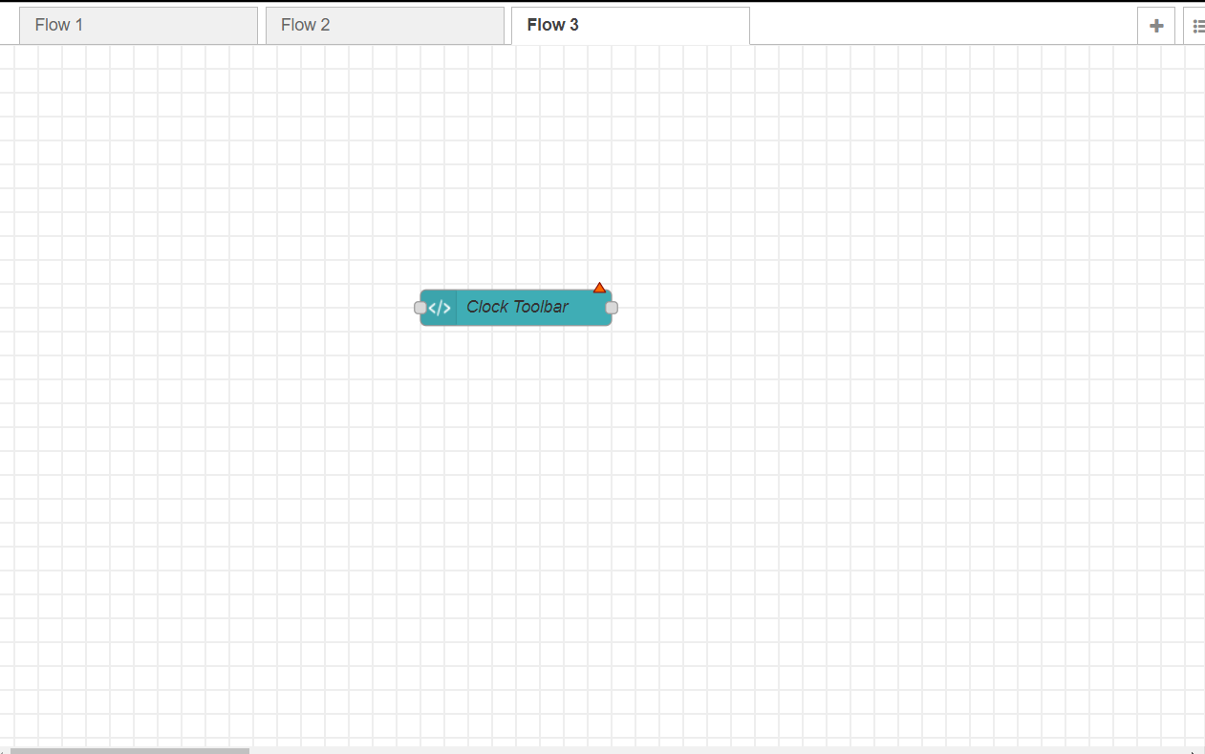
Node-Red

Slide 5
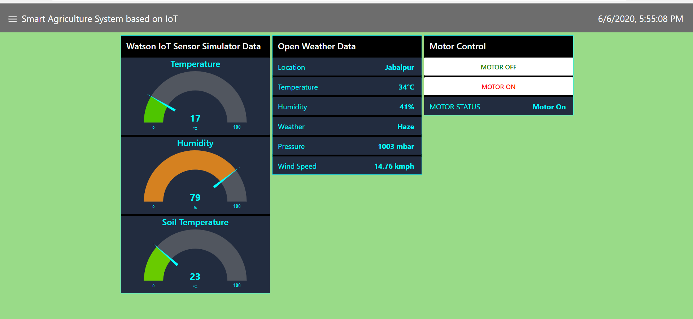
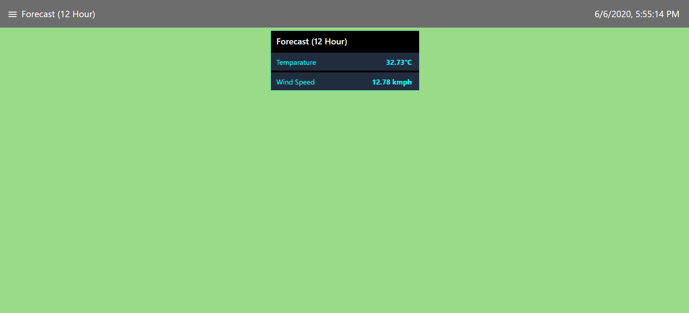
Web App

Slide 6
Thank You

